Slide 1
Scoil Ruáin
Transition Year
2023 - 2024

Slide 2
What is Transition year?
Transition Year (also called TY) is a one-year programme between Junior Cycle and Senior Cycle. It is designed to act as a bridge between the two by helping the transition or change from the more dependent learning of the Junior Cycle to the more independent self-directed learning required for the Senior Cycle

Slide 3
Mission Statement
To promote the personal, social, vocational, and educational development of students and to prepare them for their role as autonomous and participative members of society”

Slide 4
Aims
To foster the student’s personal growth, development and confidence
To develop the social skills of the student
To engage in preparation for a healthy, active life
To foster an appreciation of culture, and the arts
To celebrate the religious and spiritual side of each individual
To develop education for maturity with the emphasis on personal development including social awareness and increased social competence.
The promotion of general, technical and academic skills with an emphasis on interdisciplinary and self-directed learning.
To develop education through experience of adult and working life as a basis for personal development and maturity.

Slide 5
Benefits of TY
Opportunity to mature
Get a taste of working in your chosen future career
Develop individual personality
Develop confidence in dealing with people
Sample activities you wouldn’t normally experience
Develop friendships
Allowed the time to reflect on future careers and third level options

Slide 6
Benefits of TY
Develop teamwork skills
Work on academic areas of weakness and strengths
Discover new talents
Given time to take on more responsibility
Sample new subjects
Opportunities to accomplish certs e.g. Food Safety , Microsoft
Learn research skills
Develop public speaking skills

Slide 7
Curriculum
Irish | English
Maths/English /Gaeilge | French/German
Engineering | Science
Geography | History
DCG | Music
Art | Ethics and Beliefs
Enterprise | European Studies
Home Economics | IT
Careers | PE
DIY/Junk Kouture/Tourism/Sustainability /Forensic Science

Slide 8
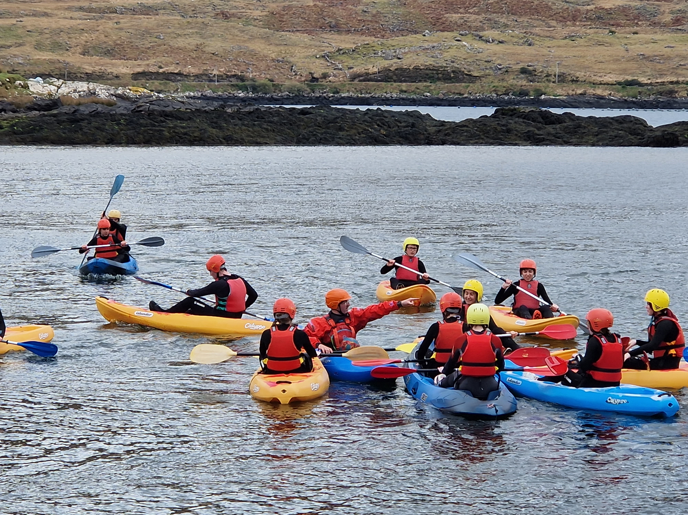
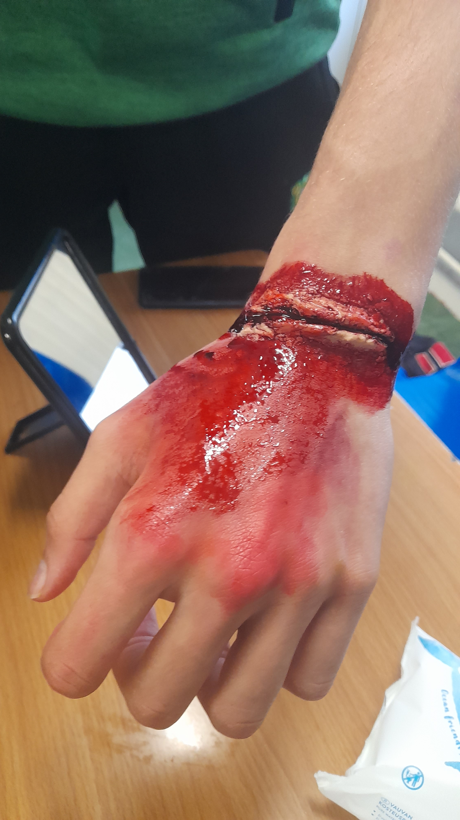
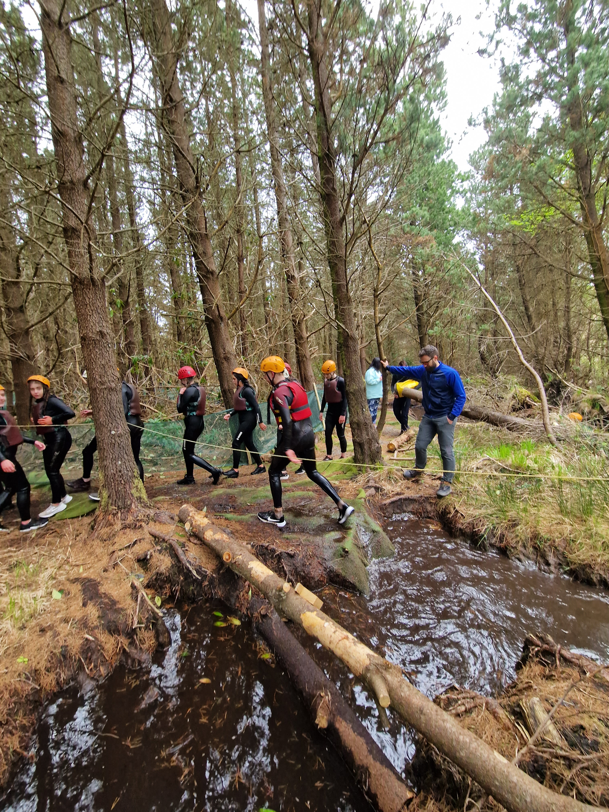
Activities
Hospitality | Bog snorkelling
Strength and Conditioning | Stage design
First Aid | Swimming
Choreography | Team bonding
Scarecrow making | Zip line
SFX | Dancing
Community spirit | Inter schools activities
Trips – Paris/Delphi | Cinema

Slide 9
External Courses
Royal College of Surgeons TY mini med programme
An Garda Siochana work experience programme
Open University free courses

Slide 10
Students are encouraged to secure a placement in an area they would like to pursue as a future career
Students are responsible for finding their own placement
Work Experience takes place Monday 6th November for one week and again Monday 19th February.
Students must keep a detailed reflective diary of each day for each day of placement

Slide 11
Certification
Awards
Distinction
Merit
Pass
Participation

